Slide 1
LightGradiant BOOSTING REGRESSOR or LIGHT GBM
Light GBM uses a novel technique of Gradient-based One-Side Sampling (GOSS) to filter out the data instances for finding a split value while XGBoost uses pre-sorted algorithm & Histogram-based algorithm for computing the best split.
Here instances are observations/samples.

Slide 2
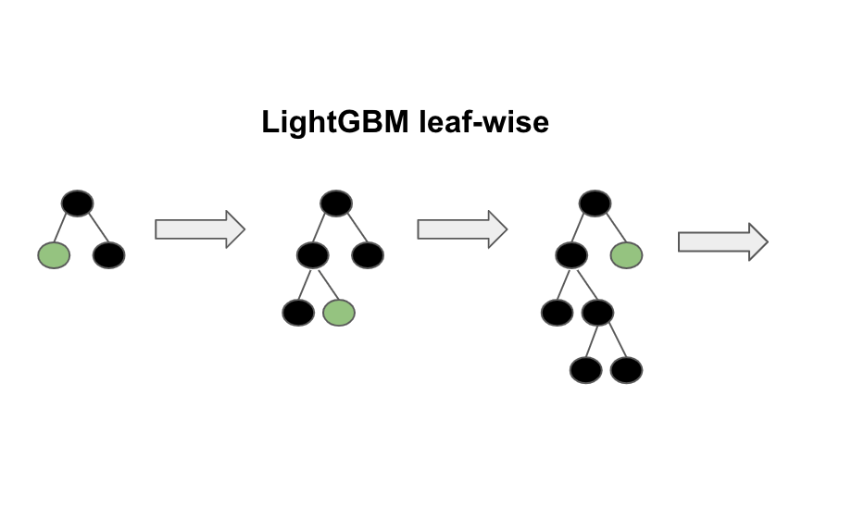

Slide 3
LG BOOSTER
LightGBM will by default consider model as a regression model. learning_rate: This determines the impact of each tree on the final outcome. GBM works by starting with an initial estimate which is updated using the output of each tree. The learning parameter controls the magnitude of this change in the estimates.

Slide 4
LG BOOSTER
Light GBM is generally faster and more memory-efficient, making it suitable for large datasets.
ADVANTAGES
Better accuracy than any other boosting algorithm:
It produces much more complex trees by following leaf wise split approach rather than a level-wise approach which is the main factor in achieving higher accuracy.

Slide 5
Example code:
model = LGBMRegressor()
cv = RepeatedKFold(n_splits=10, n_repeats=3, random_state=1)
n_scores = cross_val_score(model, X, y, scoring='neg_mean_absolute_error', cv=cv, n_jobs=-1, error_score='raise')
print('MAE: %.3f (%.3f)' % (mean(n_scores), std(n_scores)))
# fit the model on the whole dataset
model = LGBMRegressor()
model.fit(X, y)

